Slide 1


CW
Oct 5, 2019
5. What is reflection?
What is the Doppler Effect?
Describe how the doppler effect works.
Give an example of the use of the Doppler effect.

Slide 2

Learning objectives
Use the law of reflection (the angle of incidence equals the angle of reflection).
Draw ray diagrams to illustrate reflection and refraction.

Slide 3
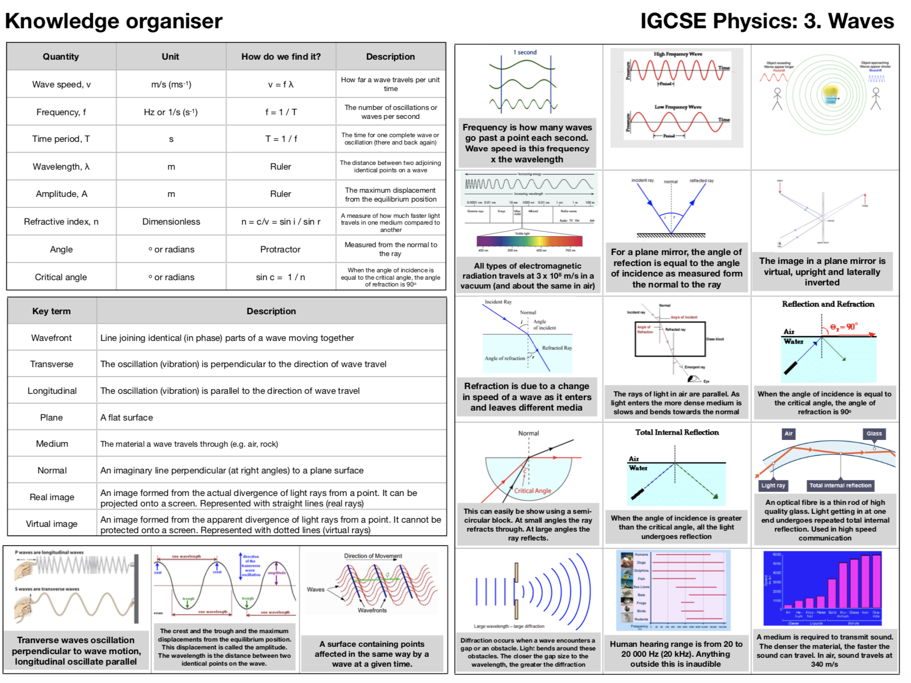

Slide 4


x
x
Angle of
incidence, i
Angle of
reflection, r
x
x
plane mirror

Slide 5
What is reflection?
Angle of incidence, i / º | Angle of reflection, r / º
Draw a graph of I against r
Instructions
Question: What is the relationship between the angle of incidence and the angle of reflection?
Place the mirror on the bottom of your page
Draw a line under the mirror so it can be replaced there
Draw the normal from the middle of the mirror
normal
Shine a ray of light to the point where it crossed the normal and the mirror
x
Mark two crosses within the incident ray and reflected ray.
50º
Use a ruler to draw in the rays of light.
x
Use a protractor to measure the angle from the normal to the rays for the incident and reflected ray and record.
mirror
Repeat with at least five other angles.

Slide 6

What are the colours of the rainbow?
What is the most popular color of Toyota Landcruiser?
Explain your answer.

Slide 7

What are the colours of the rainbow?
What is the most popular color of Toyota Landcruiser?
Explain your answer.

Slide 8

What is Pepper’s ghost?
Describe how it works.
Explain how it works.

Slide 9
Image in a plane mirror
Look at the words on the right. Cross out any that do not apply to the image that you construct on the right of the mirror.
Property | Description
Virtual | Cannot be displayed on a screen
Real | Made of real rays
Upright | Right way up
Inverted | Upside down
Magnified | Larger than the object
Diminished | Smaller than the object
Instructions
Place the mirror along the mirror line.
Look into the mirror from where the eye is drawn.
You will be able to see the arrow in the mirror
Sketch where the mirror image of the arrow is.
How far away is the image from the mirror?
Use a ruler to draw in the rays of light. The lines should be dotted.
Use a protractor to ensure the the angle of reflection is equal to the angle of incidence. Use a normal to help.
Draw in the image in the appropriate place.

Slide 10
Learning objectives
Use the law of reflection (the angle of incidence equals the angle of reflection).
Draw ray diagrams to illustrate reflection and refraction.

Slide 12
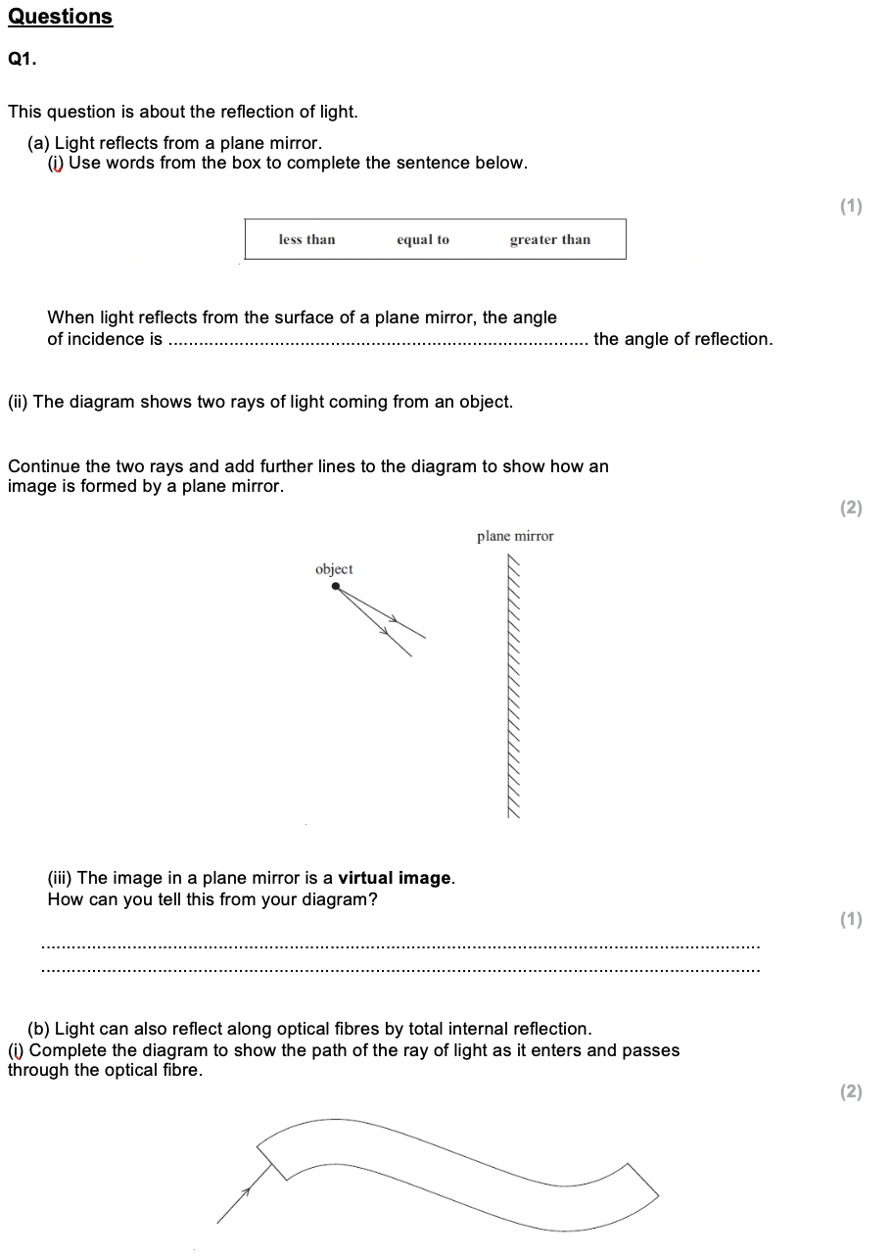
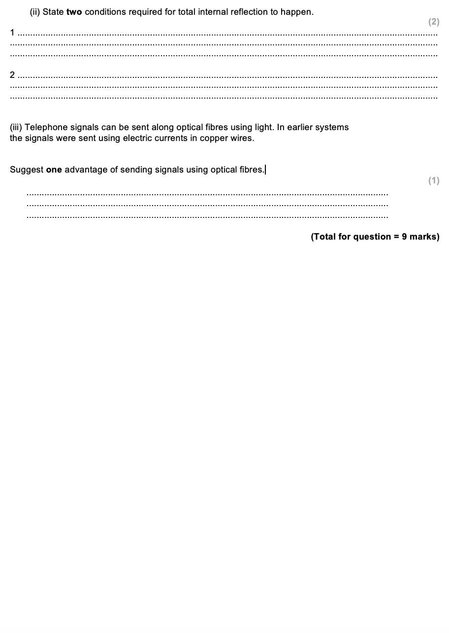

Slide 13
More optically dense
Angle of incidence greater than angle of reflection
equal to
Less noise
Rays do not meet at the image

